Slide 1

Churn Predictive Analysis

Slide 2

1
Problem Statement
Exploring the Multiple Possible Solutions
2
Our Proposed Solution
3
4
Complete Workflow – From Raw Data to Insights
Foundation of Accurate Predictions – Data Cleaning
5
Contents
6
Step 1 – Removing Non-Informative Features
7
Step 2 – Dropping Incomplete Rows
8
Step 3 – Converting Categorical Data
9
Splitting Data For Reliable Evaluation
10
Model Training, Tuning, Evaluation
Results: Predictive Insights Made Easy
11
Completion and Acknowledgement
12

Slide 3

1
Problem Statement

Slide 4
Problem Statement
A leading company is facing a decline in sales and a significant drop in customer retention. To resolve this, we were tasked to identify churned customers and analyze why they are leaving.

Slide 5
2
Exploring the Multiple Possible Solutions

Slide 6
Possible Solutions
To address the problem of customer churn and sales decline, several potential solutions were evaluated:
Customer Feedback Analysis Use sentiment analysis and surveys to gauge customer dissatisfaction.
Segmentation-Based Retention Group customers based on behavior and provide personalized offers to prevent churn.
Behavioral Triggers & Alerts Monitor service usage trends and send proactive offers or interventions.
Churn Prediction with Machine Learning (Our Approach) Use historical customer data to build a model that can predict churn probability.
These approaches are often used independently or in combination. However, for this project, we focused on a data-driven, automated churn prediction system using machine learning and Power BI for usability and insights.

Slide 7
3
Our Proposed Solution

Slide 8
Our Proposed Solution
We developed a predictive analytics model that identifies which customers are likely to churn based on historical patterns in their data.
Key Aspects of the Solution:
Built using Python and the XGBoost algorithm for high accuracy.
Designed to be user-friendly, even for non-technical stakeholders.
Integrated directly with Power BI, enabling:
Easy data upload in .csv or .xlsx format.
Automatic model execution and result visualization.
Displays key metrics like churn probability, accuracy, precision, and confusion matrix — all in a single interactive dashboard.

Slide 9
4
Complete Workflow – From Raw Data to Insights

Slide 10
End-to-End Project Workflow
Data Ingestion
Data Cleaning
Feature Selection
Interactive Visualization
Train-Test Split
Model Training
Model Evaluation
Model Integration

Slide 11
5
Foundation of Accurate Predictions – Data Cleaning

Slide 12
Why Data Cleaning is Crucial ?
Data cleaning is the most critical phase in any machine learning project. It ensures the data is complete, reliable, and ready for modeling.
Why it matters:
Raw data often contains nulls, inconsistencies, and irrelevant values.
Poor quality data can lead to wrong predictions, low accuracy, and misleading business decisions.
Cleaned data improves model performance, interpretability, and stability.
In this project, we implemented multiple cleaning techniques, each with a specific purpose, ensuring only high-quality data was fed to the model.

Slide 13
6
Step 1 – Removing Non-Informative Features

Slide 14
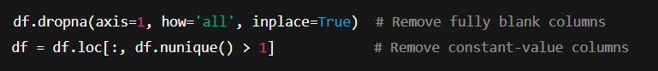
Cleaning Step – Dropping Blank & Constant Columns
Code Snippet:
Explanation:
Columns with only NaN values provide no value and waste memory.
Columns where all values are the same (like “Status = Active”) offer no decision-making power.

Slide 15
7
Step 2 – Dropping Incomplete Rows

Slide 16
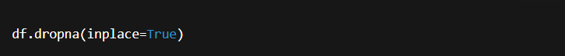
Cleaning Step – Removing Rows with Missing Values
Code Snippet:
Explanation:
Rows with missing entries may lead to errors during training.
If only a few rows are affected, it's better to remove them than guess.

Slide 17
8
Step 3 – Converting Categorical Data

Slide 18
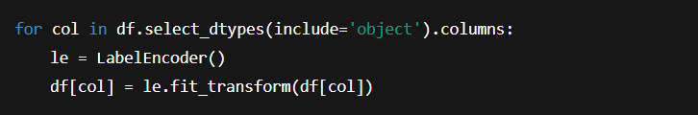
Cleaning Step – Label Encoding
Code Snippet:
Explanation:
Models can’t handle text values like “Male” or “Yes”.
Label encoding assigns numerical values to categories (e.g., Yes = 1, No = 0).

Slide 19
9
Splitting Data For Reliable Evaluation

Slide 20
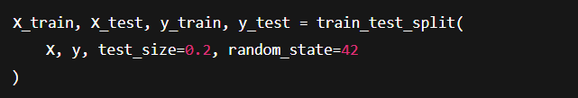
Cleaning Step – Train-Test Splitting
Code Snippet:
Explanation:
80% used for model training
20% reserved to test how well it performs on unseen data
This gives a realistic idea of how it will behave in production.

Slide 21
10
Model Training, Tuning, Evaluation

Slide 22
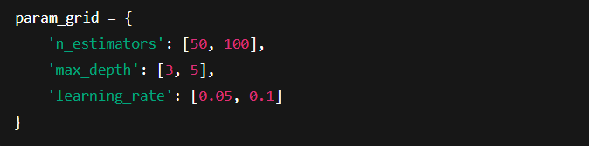
Post Cleaning Process
Main Steps:
1. Hyperparameter Tuning via GridSearchCV
This explores combinations to find the best model.

Slide 23
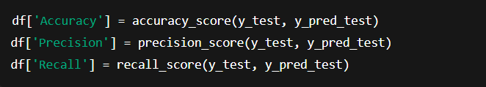
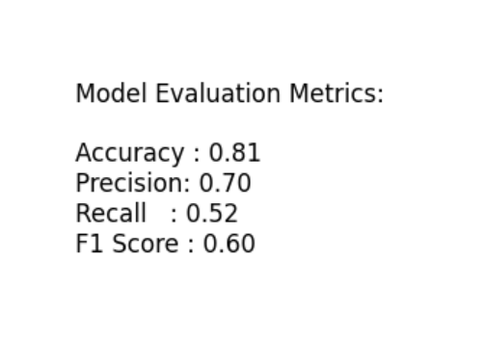
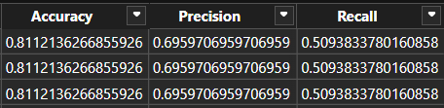
Post Cleaning Process
2. Model Evaluation Metrics Computed:

Slide 24
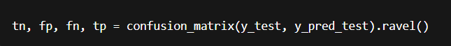
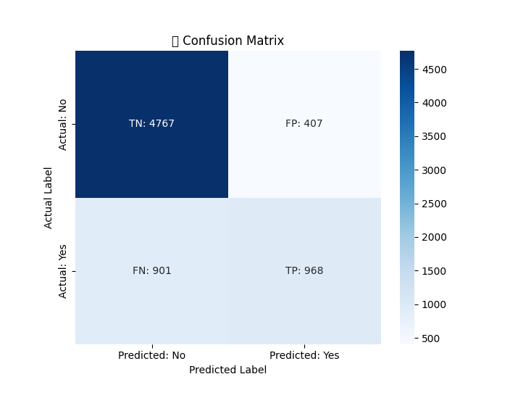
Post Cleaning Process
3. Confusion Matrix for Error Breakdown:

Slide 25
11
Results: Predictive Insights Made Easy

Slide 26
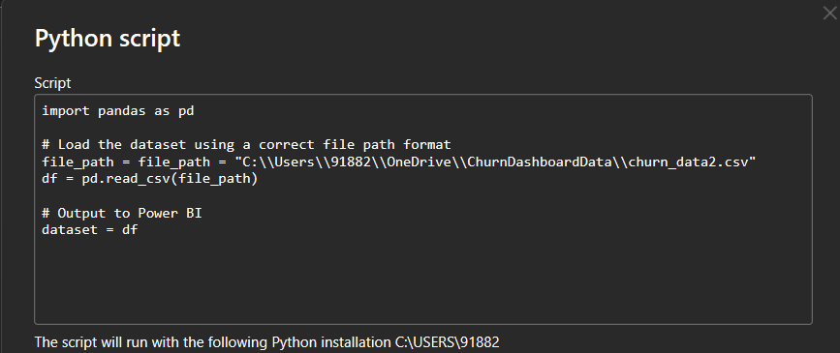

Final Output – What The Client Sees ?
Client uploads their .csv or .xlsx file into the Power BI dashboard.
This pulls the data automatically from the OneDrive folder, it is saved in.
For another Data to be analyzed, that file needs to be saved in the same folder and with the same name.

Slide 27
Final Output – What The Client Sees ?
Our integrated model automatically analyzes the dataset.
The dashboard shows:
Whether the customer is likely to churn
Confidence score (churn probability)
Model performance metrics (Accuracy, Precision, Recall)
Visualizations like pie charts, confusion matrix, and heatmaps
Goal Achieved: A fully functional solution where the client doesn’t need to run any code — just upload and explore!

Slide 28
📊 Feature Importance Plot Added to Visualizations
As discussed in the recent meeting, a Feature Importance Plot has now been integrated into the visualizations section of the Power BI dashboard.
This plot illustrates the relative importance of each feature in predicting customer churn using a Random Forest model. By doing so, it enables us to:
Identify the most influential factors leading to churn, such as tenure length, contract type, and monthly charges.
Visually understand the weight of each feature, helping to explain why certain customers are more likely to leave.
Prioritize actionable insights, allowing teams to focus efforts on the features with the highest impact on churn.
Overall, this visualization enhances interpretability and supports data-driven decision-making in our churn reduction strategy.

Slide 29
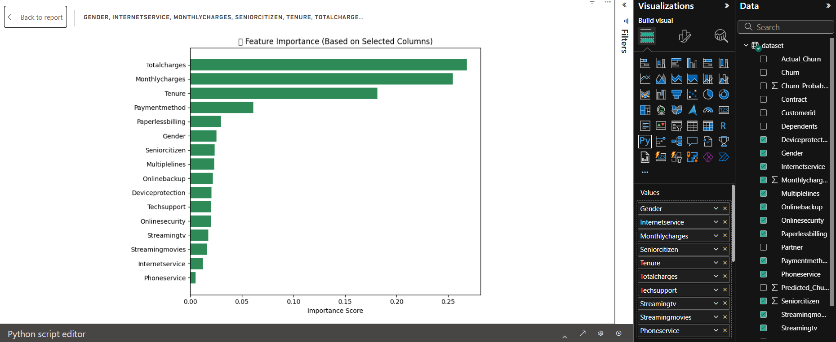
📊 Feature Importance Plot Added to Visualizations

Slide 30
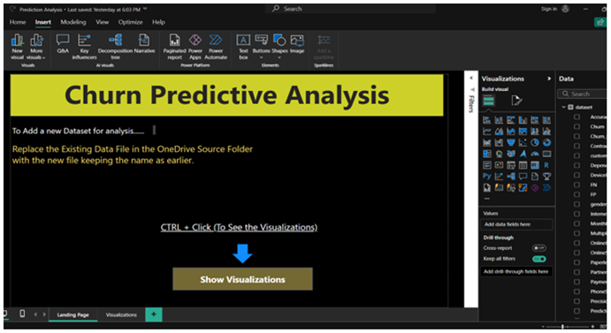
Model Insights

Slide 31
12
Completion and Acknowledgement

Slide 32
Conclusion and Gratitude
This project provided me the opportunity to build an end-to-end machine learning solution — from raw data ingestion to deployment inside Power BI.
I would like to extend my sincere thanks to:
Mr. Abhijeet Raut – for trusting me with this project and providing consistent guidance.
Mr. Manoj Kumar and Karan – for their technical input and collaborative support during various phases of the work.
Their contributions helped me overcome challenges and complete the project successfully.

